Slide 1





Attendance Management System using Face Recognition
Team Members
Guide

Slide 2
Disclaimer
The content is curated from online/offline resources and used for educational purpose only

Slide 3

Course Outline
Problem Statement
Proposed Solution
Software Requirement
System Architecture
Video of the Project
Applications
Future Scope
Conclusion
Notes:
These are the list of chapters that we are going to cover in these foundation codes. Those are chapter one what are AI and ML? chapter 2 applied Python programming in AI, and chapter 3 is exploratory data analysis for ML.

Slide 4
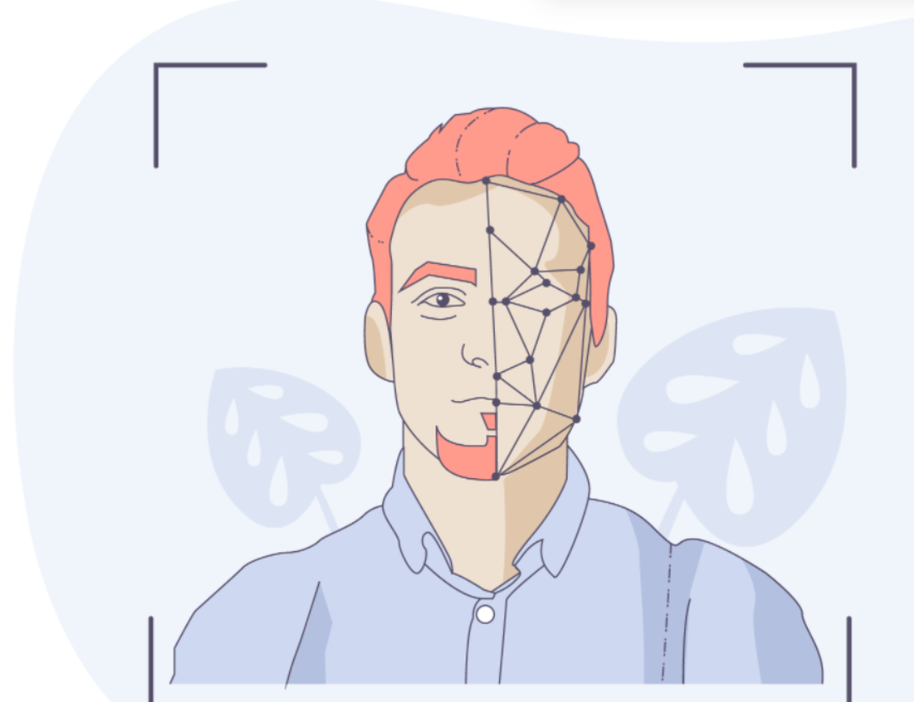
Problem Statement
To develop an automated attendance management system using face recognition technology. The system aims to reduce manual errors, improve attendance accuracy, and ensure the authenticity of student/staff attendance in classrooms or workplaces.
Notes:
Lets Understand the Problem Statement:
In the context of sustainable agriculture, timely and accurate detection of plant diseases is crucial for maintaining healthy crop yields, reducing chemical use, and minimizing environmental impact. Traditional methods of disease detection rely heavily on manual inspection, which is time-consuming, error-prone, and often requires expert knowledge that may not be readily available to all farmers. Furthermore, delayed or incorrect diagnosis can lead to the excessive use of pesticides, which harms the environment, human health, and biodiversity.

Slide 5

Proposed Solution
To effectively classify emails, a systematic approach is recommended.
Steps:
Data Collection and Preprocessing
Feature Engineering
Model Selection
Model Training
Evaluation
Deployment
Notes:
1. Data Collection and Preprocessing:
Dataset: Use publicly available email datasets like the Enron Dataset or SpamAssassin dataset.
Preprocessing:
Remove stop words, punctuation, and non-alphabetic characters.
Convert all text to lowercase.
Perform tokenization and stemming or lemmatization.
Convert emails into a numerical format (e.g., using TF-IDF or word embeddings like Word2Vec or GloVe).
2. Feature Engineering:
Text Features: Use bag-of-words (BoW) or TF-IDF vectorizer to extract text features.
Metadata Features: Include features such as:
Email length
Presence of suspicious keywords (e.g., "free", "urgent")
Number of URLs or attachments.
3. Model Selection:
Start with simple models like Logistic Regression, Naive Bayes, or Random Forest for baseline performance.
Experiment with more complex models like:
Support Vector Machines (SVM)
Gradient Boosting Machines (GBM)
Deep Learning models like Recurrent Neural Networks (RNN) or BERT for natural language processing.
4. Model Training:
Split the data into training, validation, and test sets.
Train the models on the training set using cross-validation for hyperparameter tuning.
Use metrics like accuracy, precision, recall, and F1-score to evaluate performance.
5. Evaluation:
Apply the trained model on the test set.
Assess the performance based on confusion matrix metrics and Receiver Operating Characteristic (ROC) curve analysis.
Aim for a balance between precision and recall to avoid missing too many spam emails (false negatives) or marking too many legitimate emails as spam (false positives).
6. Deployment:
Streamlit Web App: Integrate the model into a Streamlit web application to allow users to input email text and get spam or ham predictions.
Backend: Use a cloud platform like AWS or Heroku to deploy the application. Use FastAPI or Flask to handle API requests.

Slide 6






Software Requirements
Prerequisites
Python installed.
Required libraries: tinker, tensorflow (or PyTorch), opencv-python, pillow, and numpy.

Slide 7
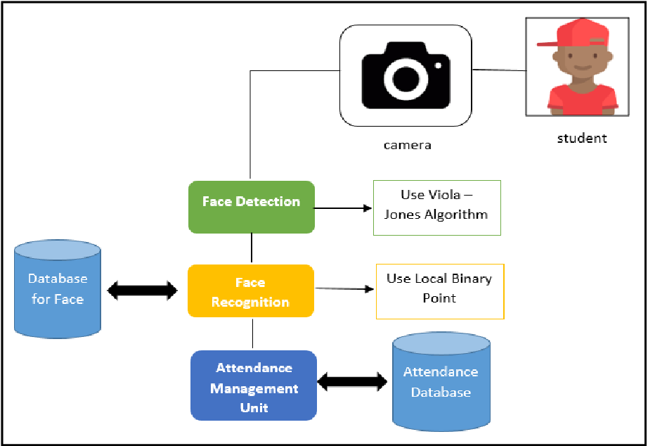
System Architecture

Slide 9

Video

Slide 10
Applications
Automated Student Attendance: Track student attendance in real-time during class, reducing manual errors and time spent on roll calls.
Exam Halls and Assessments: Ensure that only registered students are taking exams, preventing impersonation.
Parent-Teacher Communication: Alert parents about their child's attendance via SMS or email notifications.
Event Tracking: Monitor student participation in extracurricular activities, seminars, or campus events.
Employee Attendance: Automate the clock-in/clock-out process for employees using facial recognition, eliminating the need for manual punch cards or RFID tags.
Remote Attendance: For employees working remotely or in hybrid setups, face recognition can verify their attendance from home.

Slide 11
Future Scope
AI-Powered Recognition Models: As face recognition algorithms improve, attendance systems will become more accurate, even in challenging conditions like low lighting, crowded environments, or non-frontal face views.
Cloud-Based Systems: Future attendance management systems will increasingly shift to cloud-based platforms, allowing organizations to manage attendance across multiple locations, track remote employees, and access real-time data from anywhere.
Mobile Attendance Management: With more powerful mobile devices, face recognition attendance systems could become more portable. Future applications may allow employees or students to mark their attendance using smartphones, reducing the need for fixed hardware like attendance kiosks.

Slide 12
Conclusion
The future scope of these systems is vast, with promising developments in areas such as cloud integration, AI-driven data analytics, remote work support, and enhanced security measures. By leveraging deep learning, multimodal biometrics, and predictive analytics, organizations will be able to manage attendance more effectively while ensuring data privacy and compliance with regulations. The increasing affordability and accessibility of this technology will drive widespread adoption, enabling even smaller businesses and institutions to benefit from its advantages.

Slide 13
Thank you!
Notes:
Reference
These are the references for this session.
12

